Slide 1
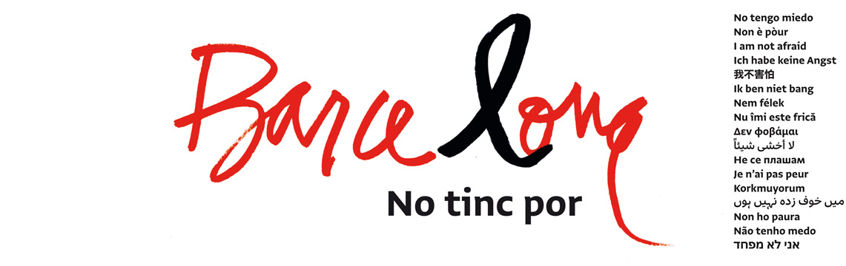
CJPE, SUMMER SCHOOL 2018. WORKSHOP 5
FROM VICTIMS TO AFFECTED PEOPLE: A NEW PARADIGM TO UNDERSTAND THE CONSEQUENCES OF A TERRORIST ATACK?
THE CASE OF THE ATTACKS IN BARCELONA AND CAMBRILS, ON 17TH AUGUST 2017: A MULTIAGENCY APPROACH
Barcelona, 5th of July of 2018

Slide 2
Why this workshop in this Seminar?
It is a local experience that had a global impact
It is a real story about an attempt to do the best we could; it is not a model
Attendants may enlarge their network contacting with local stakeholders who co-worked together.
At the end of the day, all parts involved tested on the floor what was planned, beforehand on paper
Local agencies learned a lot: much is done, more has to be done
The experience is part of the package of radicalisation, but the approach is from the other way round: the victims… or the affected people!

Slide 3
The facts: Some previous paradoxes
All we knew that something should occur: but not when, where, how, and by whom
The perpetrators changed the initial plan, due big failures in the preparation of what was planned previously
The offenders were recruited and instructed using a new-old way of changing ways of thinking, without generating external signals in a small community

Slide 4
The facts: similar components with other attacks
Modus operandi cheap and yet tested
Vans
Knives
False explosives belts
Diversification of locations, well selected for creating as much impact as possible
Barcelona (the main or the biggest, first)
Cambrils (the unexpected and small, after)
The role of the net
Instant speaker to the world
Fake news versus positive tool for individuals communication
Press for the operations on the field

Slide 5
The reaction: the during and the after started in parallel, under a change of paradigm – the scope include affected people
The during:
Activation of the own local plan for emergencies: PROCICAT
Three main groups: Injured, died people, affected people
Integral approach from different agencies: health services, police, social and psychological aid services, logistical measures, the judicial system, justice department by the Institute of legal medicine and
Office of assistance victims of crime, embassies, NGO’s.
Unique table for coordination and ensuring a right taking decisions process

Slide 6
The reaction: the during and the after started in parallel, under a change of paradigm – the scope include affected people
The after:
Contact with the Central Administration 18th August 2018
Creation of a specific multiagency commission for dealing , indeed with an integral approach, the aftermaths of the attack: 21st August 2018

Slide 7
The expected deliverables: acting for preventing!!!
On The application of current protocols:
A whole assessment of the holistic approach
A single evaluation about how did work the different separate pieces?
A deep check on how the main decisional table did its job?
A set of recommendations for improving the plans for the future
On the creation of new ways for dealing the aftermaths (people, first; then, the documents)
Involve the relevant agencies, think together first, implement a way of exchanging key information, act as a team (do not repeat, do not create black holes), assess quickly the impact of the actions on the ground, change if it is necessary the way of doing, and then…. PRODUCE A PROPOSAL OF PROTOCOL.

Slide 8
The conclusions
The need to improve the actual reaction of the DURING
Main areas for improving:
Some pieces of the protocol were not activated
Some troubles did not arrive on time to the main logistical table
The reaction was completely non symmetrical in Barcelona and in Cambrils
The need to create a culture, enough knowledge and a stable networking for the AFTER: It is important to consolidate the expertise at first door services level and at specialized services.
The evidences on the floor reinforce the scientific theory: 6 months is the time for been sure about how resilient the population is
THE TARGET IS THE WHOLE POPULATION: DIRECT VICTIMS AND THEIR RELATIVES NEED INTENSIVE CARE, BUT IF WE FORGET THE AFFECTED POPULATION THE FEAR WINS AND LIVES CHANGE.

Slide 9






WHO ARE AND WHAT THE DIFFERENT STAKEHOLDERS
DID?

Slide 10

WHO ARE WE?
Mossos d’Esquadra is an integrated police force: it is deployed throughout the territory of Catalonia.
Mossos d’Esquadra and the various local police forces make up the police force of Catalonia, to which we can add the State Security Forces and bodies that carry out the responsibilities reserved for the State.
The main functions of Mossos d’Esquadra are: legal police, security police and administrative police

Slide 11
WHAT WE DO IN RESPECT TO VICTIMS?
We allocate victims as the target of our intervention, distinguishing three main roles for them:
  As a person ( primary and main approach)
  As an owner of rights that need to be respected and applied
  As witnesses in an investigation, done under the initiative of the police itself or ordered by a judge.

Slide 12
SO, WHAT WE DO IN RESPECT ON 17TH AUGUST AND THE DAYS AFTER
  As a person: we took part in the “ante mortem” screenings, beside the Forensic Services
  We look after the respect of all the rights that assist to victims (those alive) and their relatives (of those victims died, injured or not found)
  As witnesses we reproduced their statements in order to be presented in front the judicial authorities, taking care of the guarantee of their emotional reactions.

Slide 13
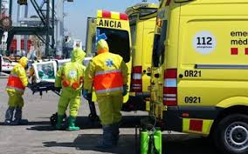
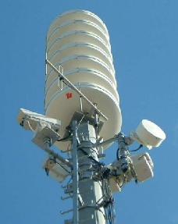
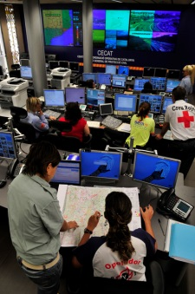
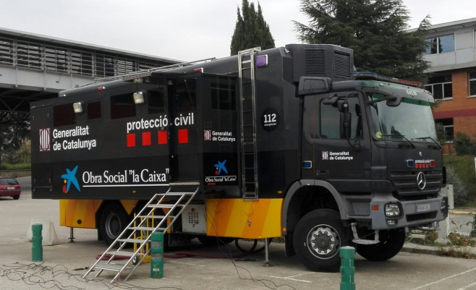
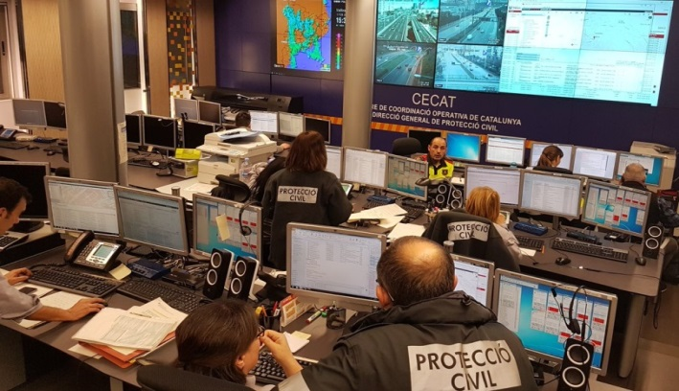
Analysis
Emergency preparedness
Planning
Risk
management
Recovery
Prevention
Response
Training and education
Emergency response
Information
Protection
Assistance

Slide 14
DURING
AFTER
Guarantee citizens rights providing
    Information
    Protection (physical)
    Assistance (psychological-social)
  Emergency Coordination
    Operational – on field
    Tactical - coordination center
    Strategical – authorities (local & regional)
Specifically, coordination of services of the logistic group - psychological-social response.
    Information
    Initial assistance – temporal shelter (derivation of direct affected citizens)
    Assistance to citizens trapped in temporary areas and in roads
    Long term shelter areas
    Assistance to relatives
    Support to police and forensic doctors in the identification process
    Injured and their relatives
Early initial coordination (<24 hours) with the responsible of the office of terrorist victims
Transfer the assistance process to the services that maintain it (health, local social and justice)
Follow up the initial actions in the after emergency

Slide 15
LESSONS LEARNED
It is needed more coordination of (inside) the psyco-social response
    Improve emergency plans and protocol
    More cooperation with health services (hospitals, …)
  It is needed a post-emergency strategy
    Develop plans and protocols in cooperation with justice and health services
    Advance in time the coordination with post-emergency services (Justice)

Slide 16



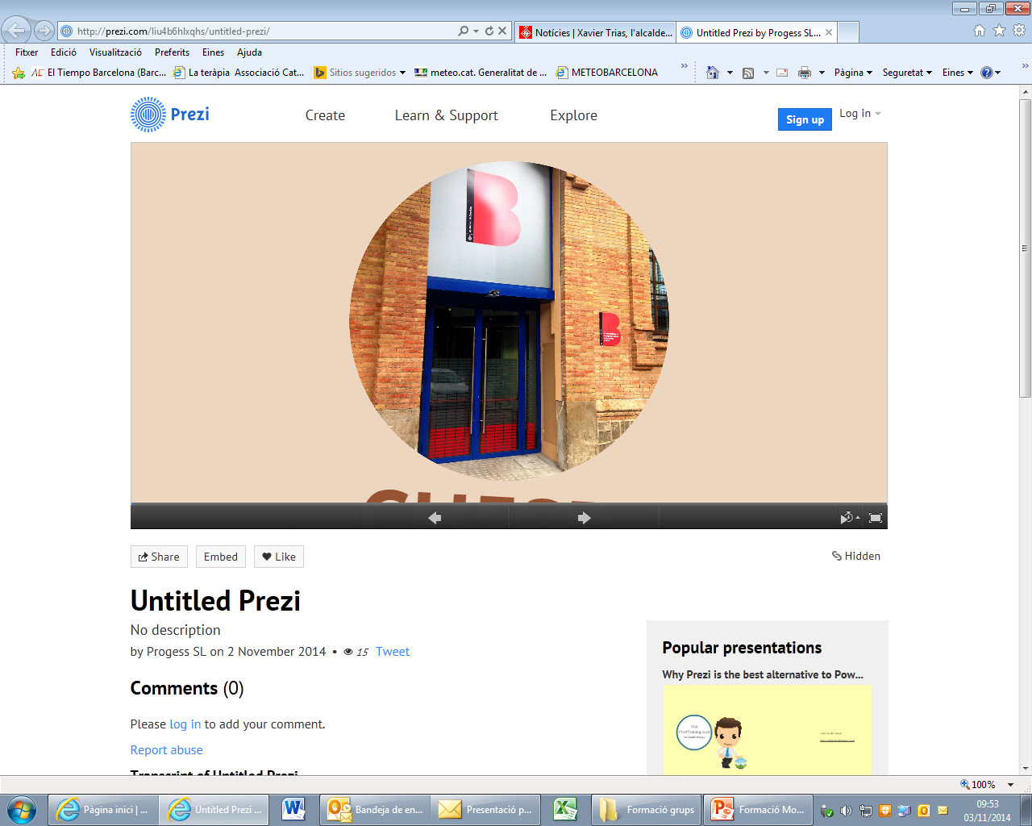
CUESB
Direction of Urgencies and Social Emergencies

Slide 17
Characteristics:
Permanent service: 24h every day of the year.
Integrates care for emergencies and social emergencies.
It establishes a unique reference center in the city.
Immediate attention to people to reduce their suffering.
Comprehensive care: coverage of basic and emotional needs.
Protocols that guarantee homogeneous attention to those affected, avoiding duplications, interferences and neglected situations.
Referring cases to the basic and specialized social services of the territory to guarantee the attention after the critical incident.

Slide 18
PSP Psychosocial Support Procedure
Objective: Establish the procedure for care for people, families or groups, who, in or outside Barcelona, are affected by critical incidents that cause such an impact, which pose a risk in the emotional balance of 'these people.
Reduce the person's suffering and minimize the risk of post-traumatic stress.
Activation: It depends on the first operated operational teams (Medical equipment - SEM, Police - MMEE, GUB, Firemen SPEIS or other qualified activators) with which we have signed protocols and agreements, which are responsible for detecting if CUESB activation is necessary for psychosocial support

Slide 19
Theoretical Framework: Classification of those affected
Affected
direct
Family members:
first and second degree of kinship
Action groups
Community:
Neighbours, schools, co-workers, etc.
First level
Second level
Third level
Fourth level

Slide 20
Some situations of high emotional impact from the CUESB
Traffic accidents, resulting in death.
Accidents provoking serious damage to people
Sudden deaths (especially on infants, children or teenagers)
Consummate suicide: in such cases it represents less media coverage, but they mean a greater prevalence with respect to other areas.
Fires, collapses, ...
Victims of situations involving extreme violence.
IMA. Incidents with Multiple Affected
Other topics conditioned to a prior assessment done by the service.

Slide 21





Areas of action 8-17
Psychological support
Logistical support
Tasks related to information, communication and prevention
Care of the victims of the terrorist attack

Slide 22




Resources
> 200 staff
Fleet with 142 vehicles
919 volunteering work shifts
209 ERIE volunteers: psychologists, social workers, lifeguards and nurses.

Slide 23
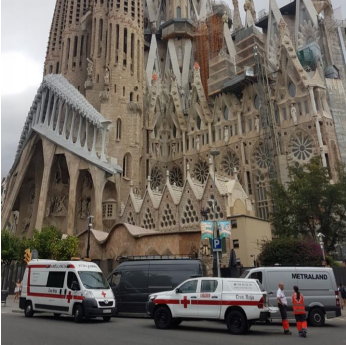
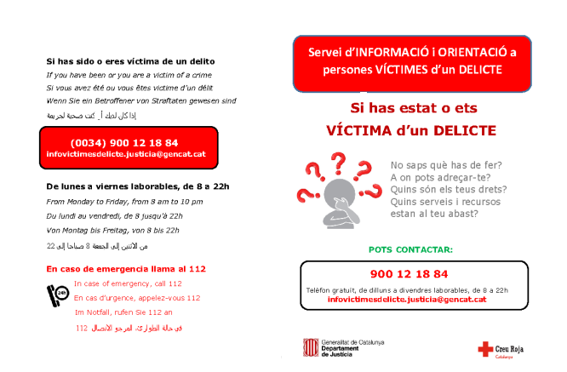
The post 8-17

Slide 24
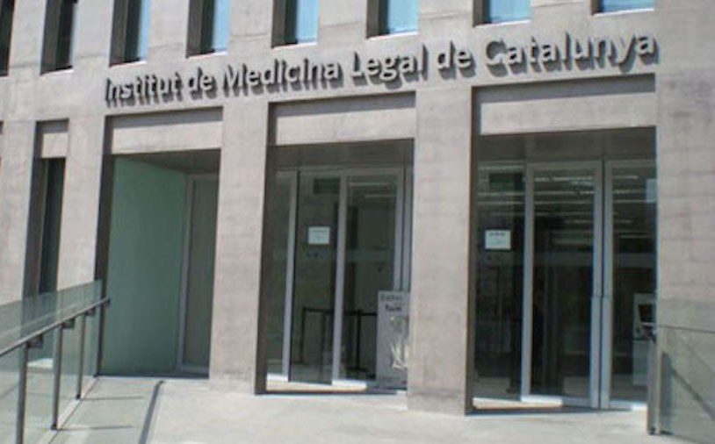
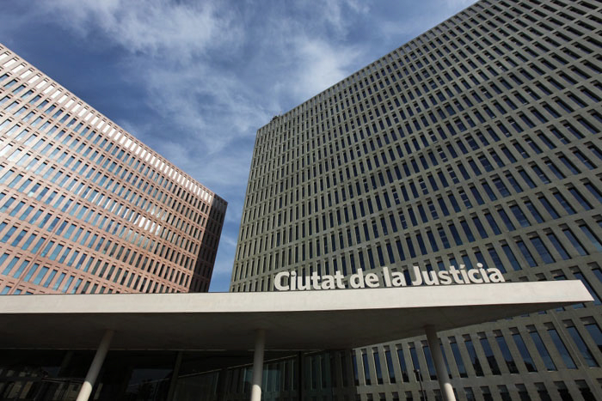
Legal and Forensic Medicine Institute
City of Justice
IMLCFC
Unit of Attention to Victims of Crime

Slide 25
DURING
AFTER
The IMLCFC took care of mortal victims creating and ad hoc “Ante Mortem Office” (identifying died people and producing the official reports to courts)
It was created a coordination and assistance point for families and relatives of died victims
This place was established in the area where the Unit of Assistance to Victim of Crime uses to work
The Justice Department acted as a hostel for the different services providing material aid to families and the staff of these services (practical needs as water, handkerchiefs, food, medical assistance, translators, coordination with the judicial system, consulates, funeral services, …
The JD participated and collaborated in the specific multiagency commission
The JD Trained staff offering two subjects:
  Psychological first aid
  Post traumatic stress detection
The JD Identified needs for attending victims on all legal areas and planned how to maximize the use of current spaces at the Justice City in case of multiple situations according with an escalation of the died people: for instance, up to 100, up to 200, or with more than 200 died people.
The JD Opened the Service of information and Orientation to Victims of Crime for all affected people, doing a proactive second round after 6 months.
The JD acted as a bypass and coordination point with the State Office of attention to the victims of terrorism placed in Madrid
The JD produced on its website of the Justice specific information concerning how to take care is such cases addressed to people affected by the terrorist attack

Slide 26


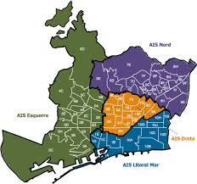
Integral Attention
The Health Consortium of Barcelona (CSB) is a public body formed by the Government of Catalonia (60%) and the Town Hall of the city of Barcelona (40%) that runs the functions of the health Region in the city of Barcelona: the designing of it, its planning and management, and the health coordination of all the stakeholders of primary and specialized care and mental and public health.
Its main goal is to offering health services based on excellence to all the citizens, adapted to their needs, looking after for the correction of the inequalities and for the inclusion of services that answer the new needs on health matters of the population, using the adequate resources in the frame of the targets fixed in the Health Plan of Barcelona.
In doing so, the CSB enhances strategy actions as, for instance, the effective coordination among the different units of the Public Health System in order to allow an integral approach to the attention offered to citizens.
http://www.csb.cat/

Slide 27



Centre of Operative Coordination of Catalonia CECAT
The whole answer
Centre of the town hall’s operative Coordination operative CECOPAL
Centre of advanced management, CCA
Intervention groups
Group of order
Logistic group
Health group
CUESB
SEM
Intermediate care
Hospitals
CUAPS
Taking care of the staff
PROCICAT
Public Health
Net of focal detector points that do not belong to the health system
Local Units
Schools
Social Services
Expert Units
Units of attention to victims of crime
Net of detector local points
Red Cross
IMLCFC
Pharmacy Units

Slide 28


The principles of the answer
Public Systems
Continuity
Sustainability
Capillarity
Proximity
 Intermediation:    victimization / re-victimization
Evolution of the client: the victim “including the offender” > the affected > the staff > the citizenship
The evolution of the matter: IMV > IMA > post IMA > pre IMA

Slide 29
Key components of the answer
PREPARATION
IMA and post IMA BCN’s plans
Centre’s plan: Hospitals, First Attention, Intermediate Attention
Particular models: social work, labour health...
THOSE AFECTED
Intervention groups
Expert groups
Territorial points
Taking care of the staff acting on the floor
http://www.aisbcn.cat/2018/01/26/pla-ima-bcn-i-postima/
POPULATION
Rounds of closing
Net for detections
Emotional education points
ASSESSMENT
Debriefings
The narrative
http://www.aisbcn.cat/2018/03/08/debriefing-ima-17ago17-acmcb/

Slide 30
Answer’s net

Slide 31
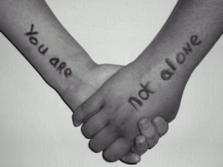
THANK YOU FOR YOUR ATTENTION

